Slide 1

Customer Data Science
Stand-up Updates
June 02, 2017

Slide 2




Key updates
Discount Sensitivity model - BF
Time to Next Purchase Models - BR
Discount Sensitivity model - AT
Click Path Analysis v2
Customer Survey Analysis
Gap Inc Confidential – Do Not Distribute or Copy Without Authorization

Slide 3
AT US discount sensitivity model
JUN 2017
PLATFORM ANALYTICS

Slide 4
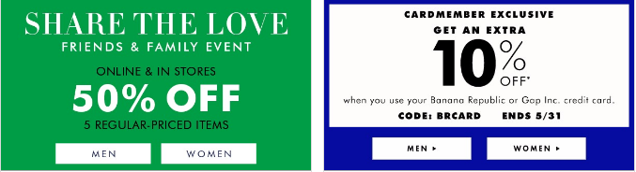

BACKGROUND
Objective:
Every year company shells out billions of $ in various discounts offered.
Not all Customers have affinity towards discounts to make a purchase.
This creates an opportunity to improve margin by offering relevant discounts to customers based on how discount sensitive they are.
The whole exercise will help in:
Increasing Revenue
Saving Cost
Definitions:
Response: customers taking above 15% of gross sales as discounts in an year
Response score: Probability of a customer to search discount above 15% to make purchase
Historical behavior
Response Window
Training
Transactions & Browse Data
Mar2015-Feb2016
Purchase Data
Mar2016-Feb2017
Validation
Transactions & Browse Data
Mar2014-Feb2015
Purchase Data
Mar2015-Feb2016
Algorithms | Library
Ensemble Leaners | xgboost, randomForest, neural network
Logistic Regression
Data preparation
Exploratory Analysis
Scaling and Outlier Treatment
Dataset Size involved : 1.9 M (Customer Keys), Response – 7%
Model Execution and Testing
Model Evaluation and Validation
Model Training

Slide 5
PREDICTORS AND RELATIVE IMPORTANCE

Slide 6
MODEL RESULTS – IN TIME VALIDATIONS MAY 15 - APR 16
Decile | Customers | Number of Responder | Cum Responders | Response Rate | Response Gain | Cumulative Response Rate | Cumulative Lift
1 | 191,894 | 68,333 | 68,333 | 35.61% | 49.66% | 35.61% | 4.97
2 | 191,893 | 22,218 | 90,551 | 11.58% | 65.81% | 23.59% | 3.29
3 | 191,893 | 13,669 | 104,220 | 7.12% | 75.75% | 18.10% | 2.52
4 | 191,893 | 9,271 | 113,491 | 4.83% | 82.48% | 14.79% | 2.06
5 | 191,893 | 6,708 | 120,199 | 3.50% | 87.36% | 12.53% | 1.75
6 | 191,894 | 5,142 | 125,341 | 2.68% | 91.10% | 10.89% | 1.52
7 | 191,893 | 4,152 | 129,493 | 2.16% | 94.11% | 9.64% | 1.34
8 | 191,893 | 3,543 | 133,036 | 1.85% | 96.69% | 8.67% | 1.21
9 | 191,893 | 2,698 | 135,734 | 1.41% | 98.65% | 7.86% | 1.10
10 | 191,893 | 1,859 | 137,593 | 0.97% | 100.00% | 7.17% | 1.00
Model Summary:
Among many models , XGBoost algorithm was picked based on model performance.
Out of 200 XGBoost models, best 30 have been picked and data is scored . Ensemble of median score was taken as final probability which was used for validation

Slide 7
CUSTOMER SURVEY ANALYSIS
JUN 2017
PLATFORM ANALYTICS

Slide 8
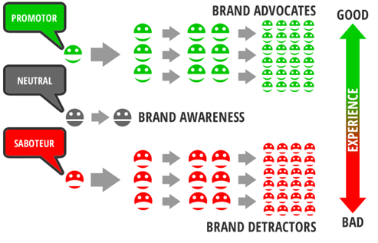
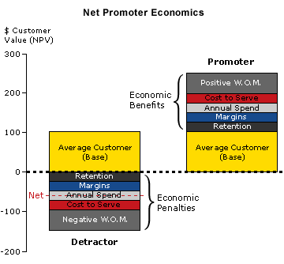
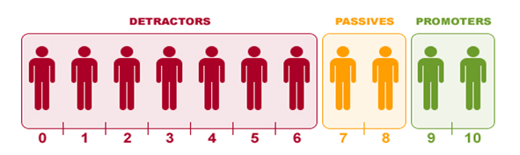
BACKGROUND
Objective:
Gap Inc. acquires millions of new customers every year over multiple brands across diverse geographies
Customer engagement satisfaction across touchpoints like retail and online decides future brand value
Satisfied Customer will promote the brand where unsatisfied customer will detract other by bad word of mouth
Potential Outcome:
Identify the business drivers which decide customer satisfaction and improve the same
Whether the satisfied customers brings better value in near term than the detractors
Here numbers are only for directional purpose

Slide 9
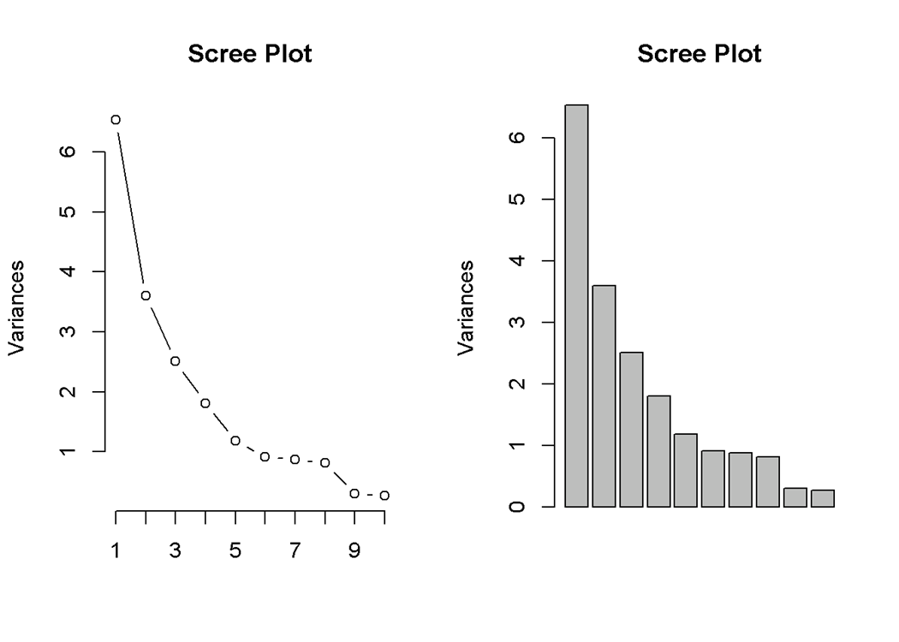
PCA Analysis over the Questionnaire
PCA: Orthogonal linear transformation of data to a new coordinate system such that first coordinate explains greatest variance of data, and so on
We have total 28 Attributes/questions in survey
20 of them have less than 90% missing value
Importance of components%:
 | PC1 | PC2 | PC3 | PC4 | PC5 | PC6
Standard deviation | 2.5568 | 1.9205 | 1.7802 | 1.3452 | 1.08749 | 0.96078
Proportion of Variance | 32.68% | 18.44% | 15.85% | 9.05% | 5.91% | 4.62%
Cumulative Proportion | 32.68% | 51.13% | 66.97% | 76.02% | 81.93% | 86.55%
Attribute | Attribute | Attribute | Attribute
Fit Overall | Brand Connection | Great Experience Cash Wrap | Brand Connection Comps
In Stock Overall | Brand For Me | Great Experience Sales Floor | Brand For Me Comps
Quality Overall | Easy to Shop | Likelihood to Recommend | In Stock Overall Comps
Style Overall | Inspiring Shopping Environment | Overall Satisfaction | Mobile Store Handoff Sat
Value Overall |  |  | Online Store Handoff Sat
Versatility Overall | Great Experience Fitting Room
We had 28 attributes
After removing attributes with 90%+ missing values, 20 attribute have been grouped

Slide 10
Hypothesis : LTR has anchoring effect over other attributes
Attribute Importance from regression
Strength of relationship between Likelihood to recommend over other attributes raw score:
We fit a linear regression keeping LTR as response and other attributes as predictors : adj-R square – 0.728
We fit a logistic regression by formulating a binary classification problem. Where Promoters are event of interest. AUC 0.94, Accuracy :0.896
Strength of relationship between Likelihood to recommend and top 6 principal components:
We fit a linear regression keeping LTR as response and top 6 principal components as predictors : adj-R square – 0.69
We fit a logistic regression by formulating a binary classification problem. Where Promoters are event of interest. AUC 0.92, Accuracy :0.886
Conclusion: It has been proved that customer scores vary similarly in other attributes as they do in “Likelihood to Recommend”

Slide 11
Thank you

